Slide 1

App Monitoring
App Monitoring Metrics and Data, Types, Prometheus Tool, Alerting, Alertmanager, Visualization, Grafana
Technical Trainers
SoftUni Team
https://softuni.bg
Software University

Slide 2
Have a Question?
sli.do
#QA-Auto-BackEnd
Notes:
2

Slide 3
Table of Content
App Monitoring
Prometheus
Alerting
Grafana
ElasticStack

Slide 4

App Monitoring

Slide 5
What is Application Monitoring?
Application monitoring
The process of tracking and measuring the performance, availability and user experience of software application in real time
Goal
Ensure that apps are running smoothly and identify and resolve any performance or availability issues
Application monitoring is not an easy job due to the dynamic nature of cloud environments

Slide 6
App Monitoring Metrics and Data
Application monitoring involves collecting metrics and other data related to the performance of the app and the overall infrastructure
This can include information such as CPU and memory usage, network traffic, etc.
When data is collected, it can be analyzed to indicate issues or potential problems
Alerts can be set up to notify when thresholds are exceeded or specific events occur

Slide 7
Types of App Monitoring
Uptime / availability monitoring
Continuously poll the app to confirm that it's up and responding to the requests it receives
Performance monitoring
Ensure your software launches fast and responds to commands in a timely manner
Error monitoring
Keep an eye on errors and their frequency

Slide 8
Types of App Monitoring
Log monitoring
Collect and analyze logs from various sources
Database monitoring
Examine the communication between the app and its database, as well as the database performance
Security monitoring
Look out for malware signatures and flag anomalous or suspicious system activity

Slide 9
Monitoring Rooms
Software monitoring rooms (Network Operations Centers) are facilities, where engineers monitor and manage software systems and networks
Engineers typically use
Large screens to monitor the systems health in real-time
Alarms in case of emergency / downtime
Notifications: Slack / SMS / email / phone calls / etc.

Slide 10
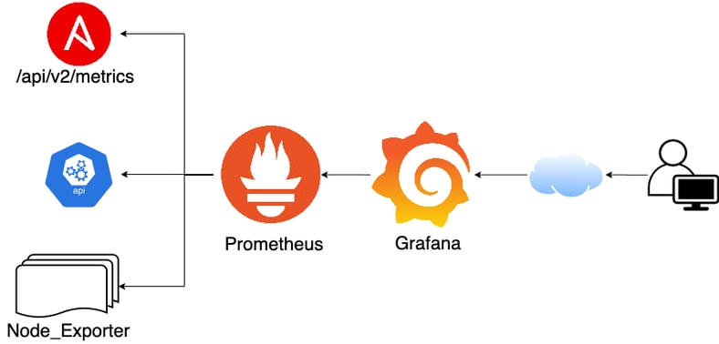
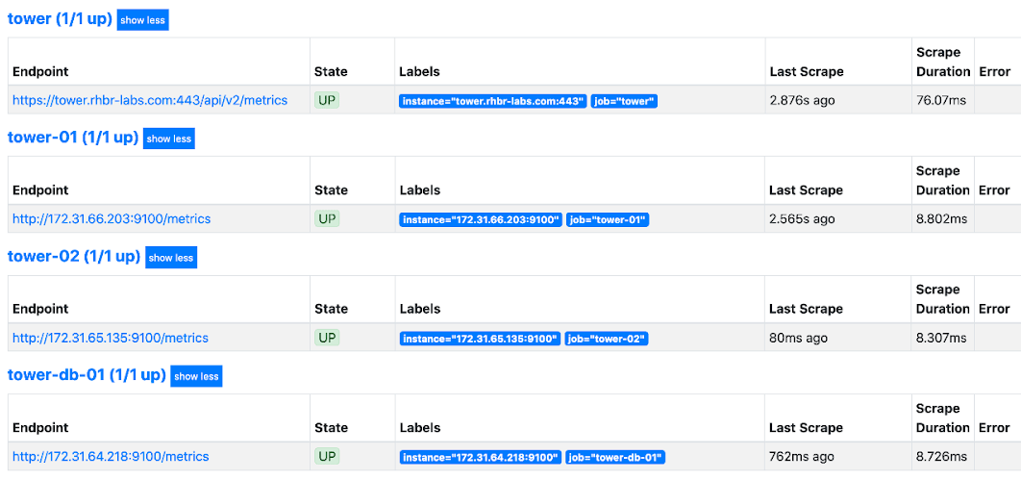
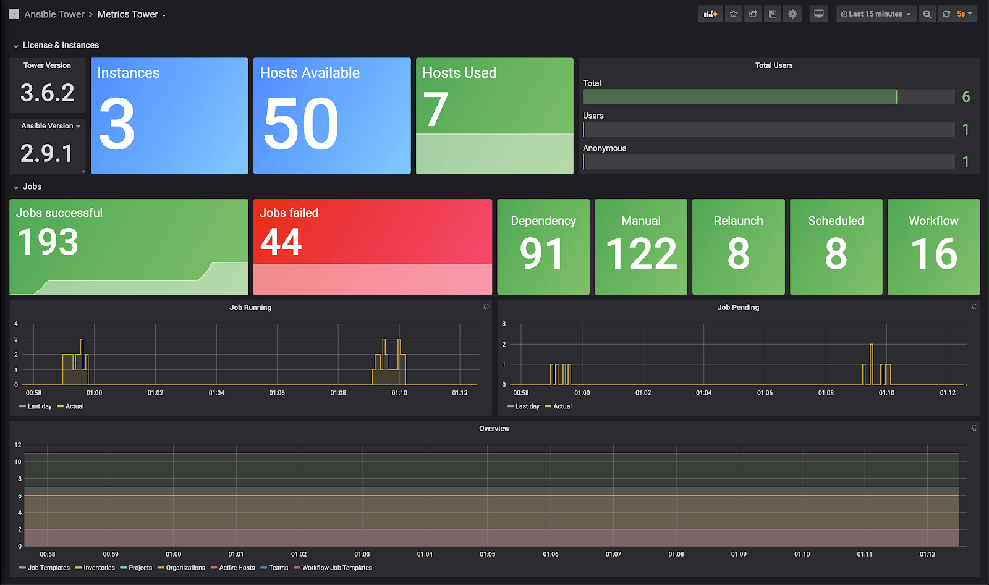
App Monitoring Tools – Prometheus + Grafana
App monitoring data is often collected using specialized monitoring tools
Prometheus is a monitoring tool for storing time series data like metrics and Grafana visualizes this data

Slide 11




More App Monitoring Tools
Datadog
Provides comprehensive end-to-end visibility
New Relic
Cloud-based monitoring tool
Instana
AI-powered observability platform
Nagios
Highly customizable open-source monitoring tool
And many more…

Slide 12

Prometheus
Collect and Monitor App Data and Send Alerts

Slide 13
What is Prometheus?
An open-source toolkit for monitoring and alerting, designed to collect and store metrics from various sources
Gains real-time insights into the health of an infrastructure
Helps quickly identify and resolve issues
Integrates well with cloud-native environments and modern software systems
Live demo: https://prometheus.demo.do.prometheus.io

Slide 14
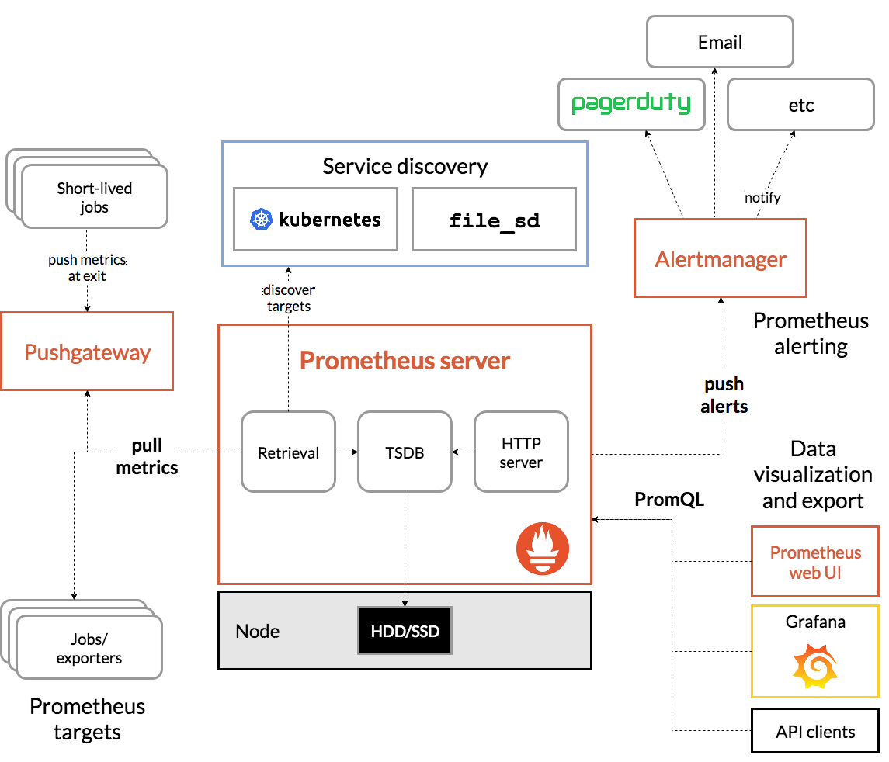
How Does Prometheus Work?
Prometheus works by continuously scraping (pulling) metrics data from target systems at regular intervals
Can scrape applications, servers, containers, databases, etc.
Data is stored in a time-series database and visualized with tools like Grafana
The database can be queried and analyzed using the Prometheus query language (PromQL)
An alerting system may also be configured to send notifications

Slide 15
How to Extract App Metrics for Prometheus?
Use pre-built exporters
Standalone apps or services that collect metrics from various sources and expose them to Prometheus
Examples: Node Exporter (Linux machines), Blackbox exporter (external services)
Instrument your app
Use client libraries to collect and expose custom app metrics
Using the Pushgateway
Allows you to push metrics to a centralized gateway, which Prometheus can scrape

Slide 16
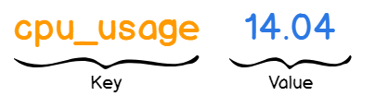
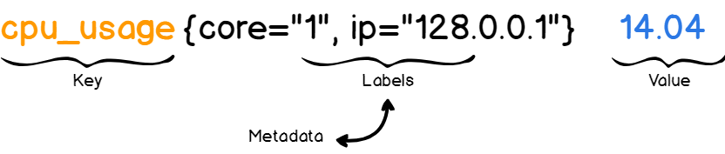
Prometheus Data Model
When Prometheus collects metrics data from a system, it organizes the data into individual time series (data point + timestamp)
Data points are key-value pairs
The key is called metric and describes what you are measuring (for example CPU rate or memory usage)
The value stores the actual measurement value, as a number
You can also provide more details to your metrics using labels (optional key-value pairs)
For example, if you want to describe CPU rate for a specific core

Slide 17
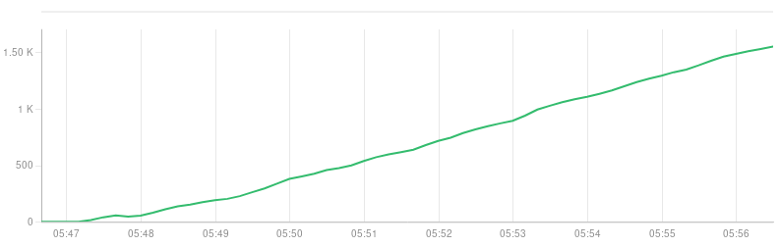
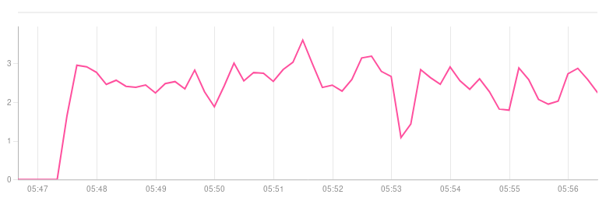
Metric Types
Counter
Only goes up or resets on restart, e.g., tasks completed, requests served
Gauge
Can go up and down, e.g., temperature, requests

Slide 18
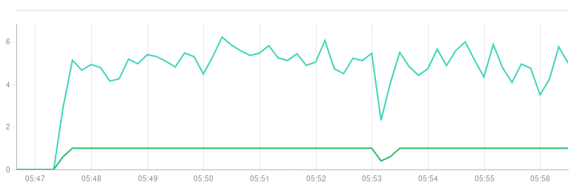
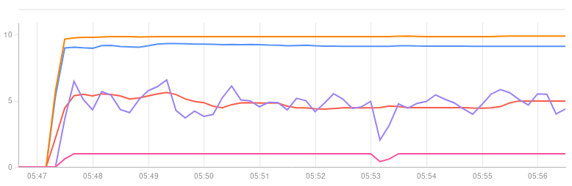
Metric Types
Histogram
Counts observations (e.g., request durations) in configurable buckets and provides a sum of all values
Summary
Like histogram, but calculates configurable quantiles over a sliding time window

Slide 19
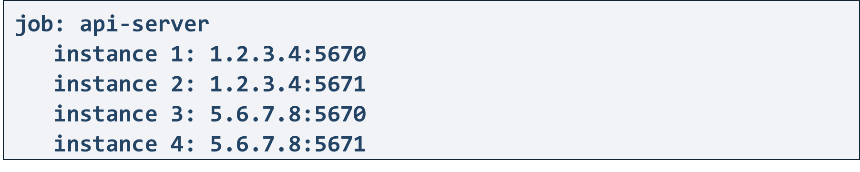
Components
Instance
An endpoint that can be scraped
Usually corresponds to a single process
Job
A collection of instances
Instances should have the same purpose
Example

Slide 20
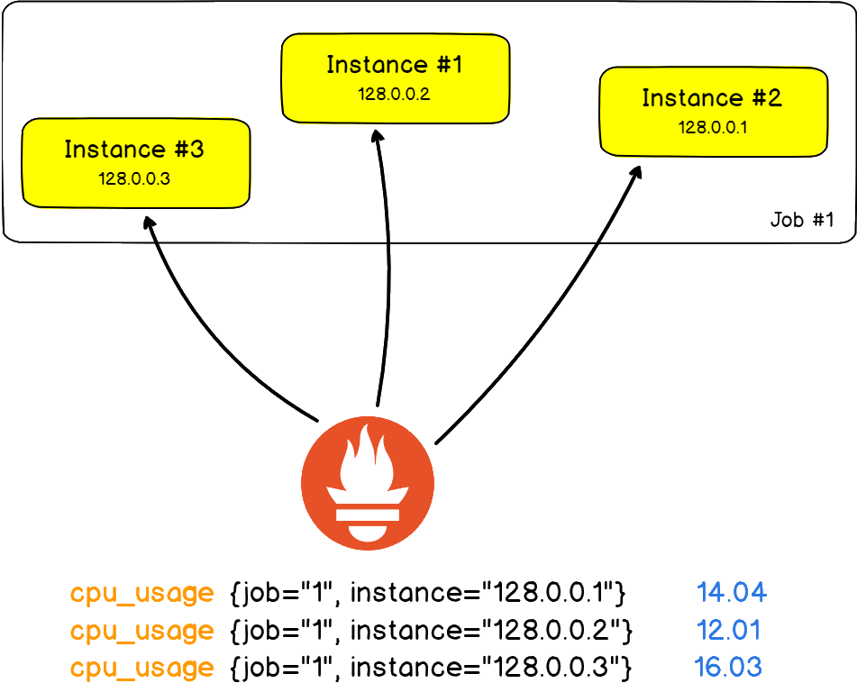
Components
When a target is scraped, two additional labels are attached – job and instance
Each instance scrape adds a sample to a set of system time series
A sample is a single value at a point in time in a time series
It consists of a float64 value and a millisecond-precision timestamp

Slide 21
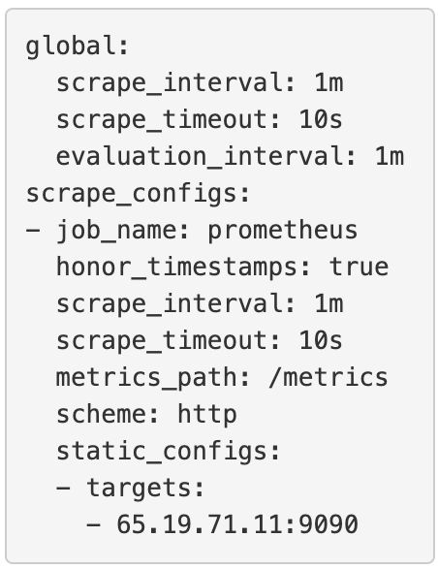
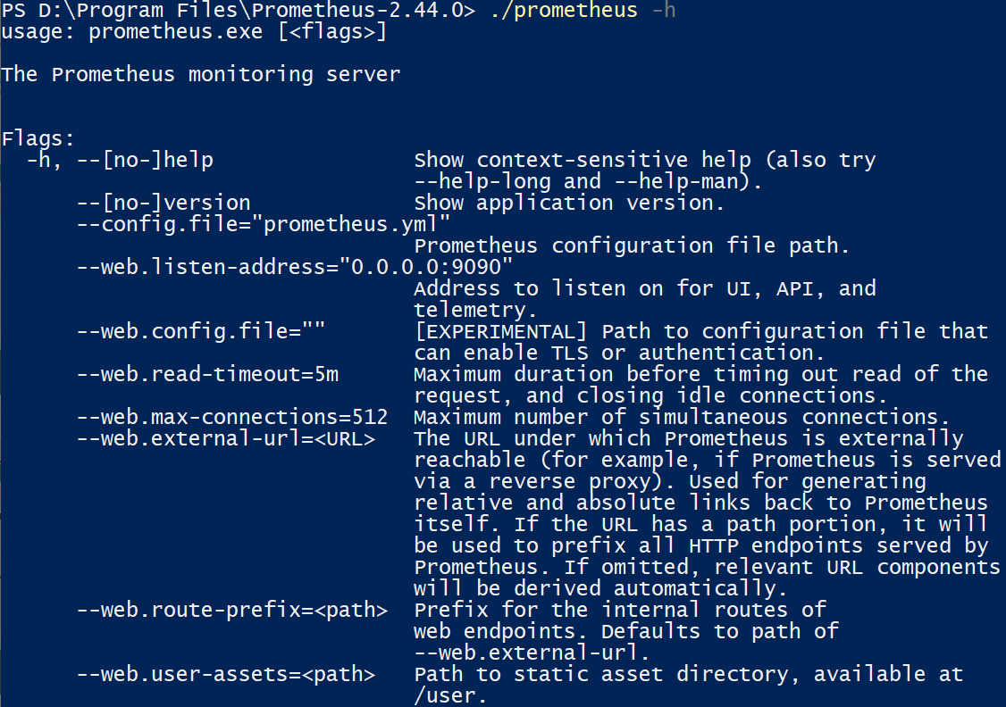
Prometheus Configuration
Prometheus is configured via command-line flags and a configuration file
Configuration file is used to control scraping and rules
It is in YAML format
Flags are used to configure immutable system parameters like storage location, amount, etc.

Slide 22

Live Demo
Install Prometheus

Slide 23
Live Demo
Prometheus and Blackbox Exporter: Run Prometheus Server that Monitors softuni.org

Slide 24

Alerting
Configure and Receive Notifications with Alertmanager

Slide 25
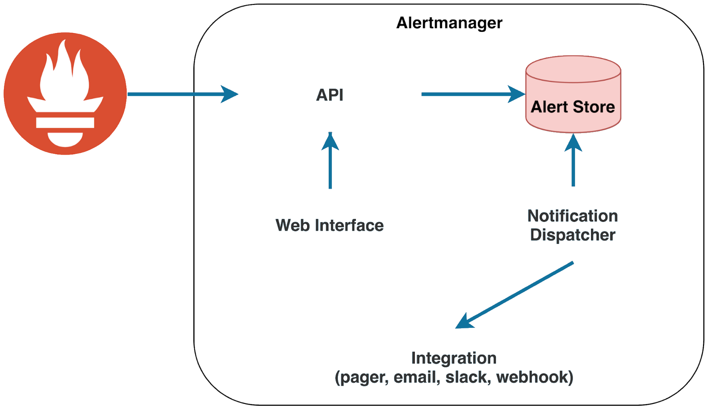
Alerting and Alertmanager
Alerting is a component of a monitoring system that performs actions based on changes in metric values
Involves setting up rules or conditions that trigger alerts or notifications when specific events or issues occur in the app
High error rates, slow response times, etc.
Alertmanager handles and routs Prometheus alerts
Live demo: https://alertmanager. demo.do.prometheus.io

Slide 26
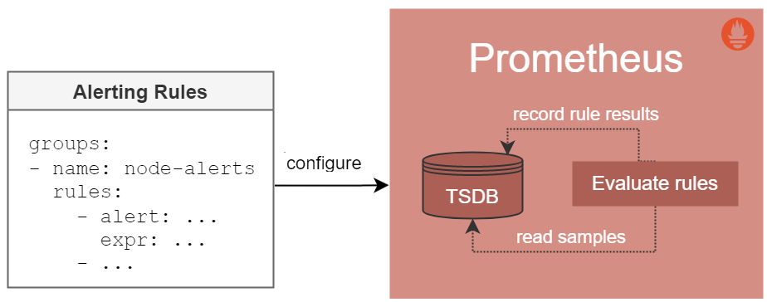
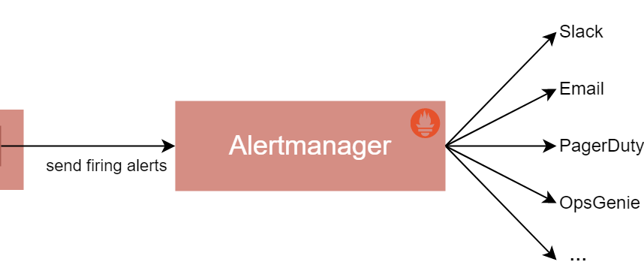
Alerting with Alertmanager
Separated into two parts
Alerting rules in Prometheus servers send alerts to an Alertmanager
Alertmanager manages alerts including silencing (mute), inhibition (suppress), aggregation (group) and sending out notifications
Notification methods: email, on-call notification systems, chat platforms

Slide 27
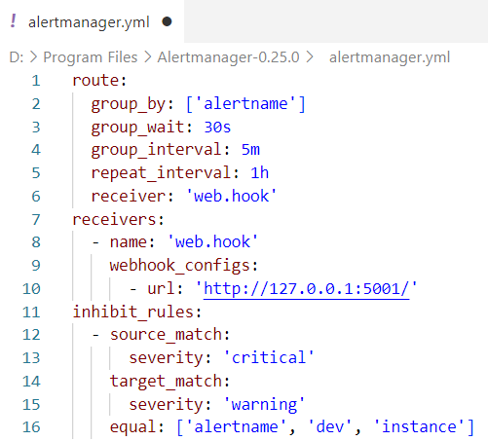
Alertmanager Configuration
Alertmanager is configured via command-line flags and a configuration file
The configuration file is in YAML format
It defines inhibition rules, notification routing and notification receivers
The "alertmanager.yaml" file we have, defines how to route, receive and manage Prometheus alerts

Slide 28
Live Demo
Install Alertmanager

Slide 29
Live Demo
Prometheus and Alertmanager: Create Alerts for Prometheus Metrics

Slide 30

Grafana
Open-source Analytics & Monitoring Solution

Slide 31
What is Grafana?
Grafana is a complete observability stack
Allows users to visualize and analyze data (metrics, logs, etc.) from various sources in real-time
You can also create flexible dashboards and alerts
Offered in 3 variants: open source, cloud and enterprise
Supports plugins and extensions for additional functionalities and integration with other tools
Live demo: https://play.grafana.org/

Slide 32
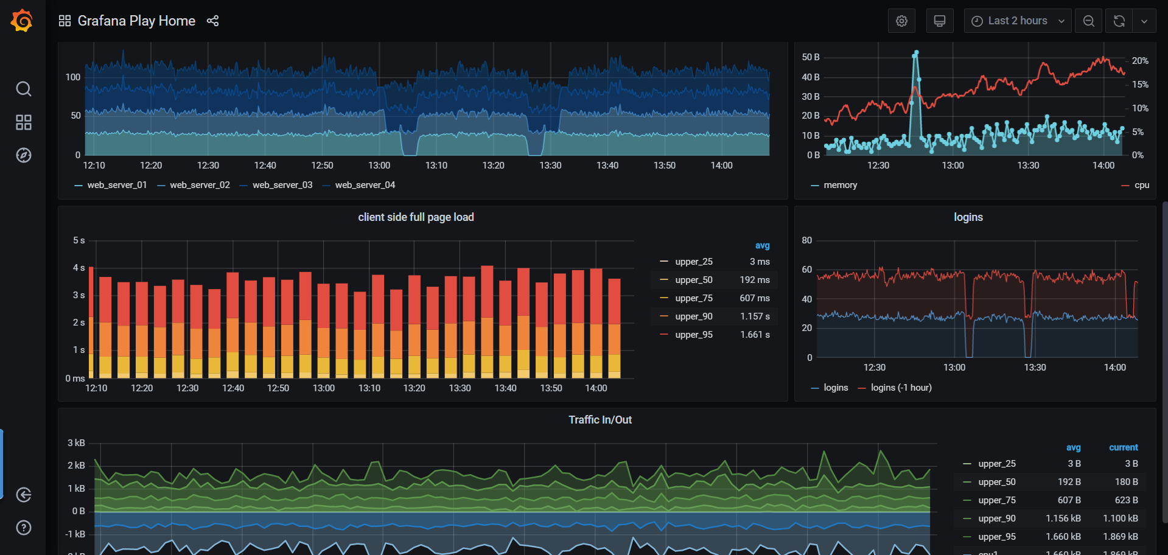
Dashboards
Grafana dashboard == a collection of panels that display data from one or more data sources

Slide 33
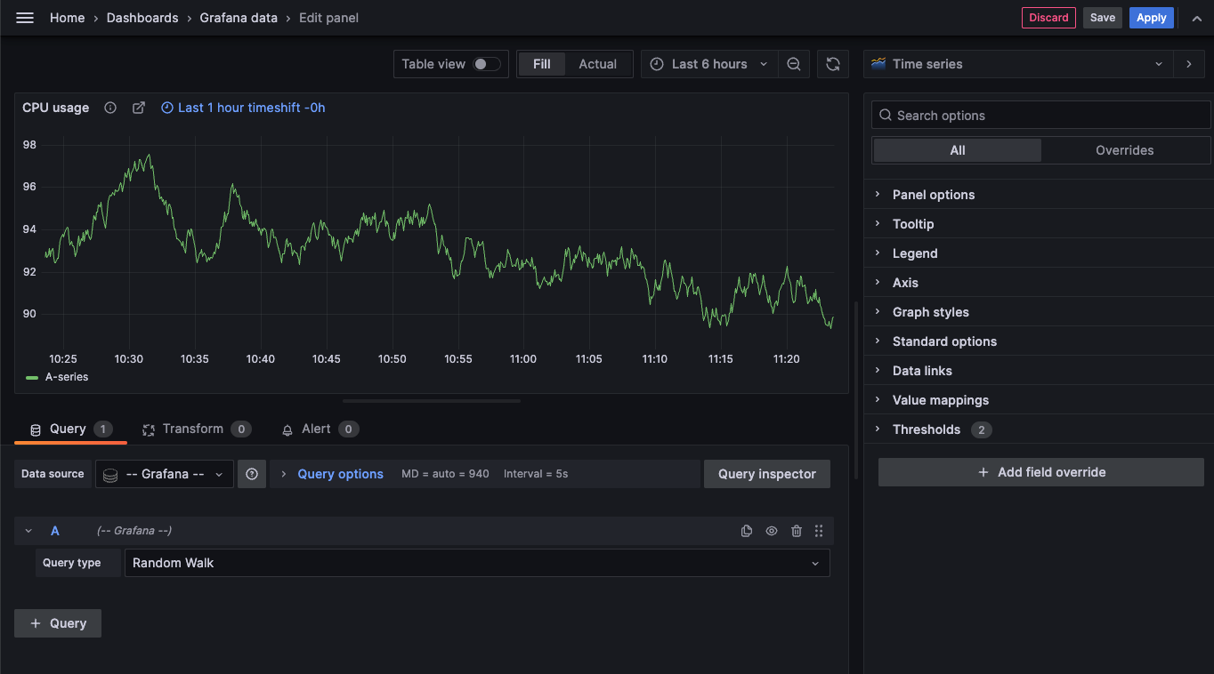
Panels
Panel == a visualization of a metric or set of metrics
Types
Graphs
Tables
Gauges
Singlestat
Panels connect via query to a data source that you want to visualize
Grafana provides many options for customizing the way data is displayed in a panel
There are different panel layout options for customizing dashboards

Slide 34
Live Demo
Install Grafana

Slide 35
Live Demo
Grafana and Prometheus: Visualize Metrics in a Dashboard

Slide 36

Elastic Stack
Flexible search and monitoring solution

Slide 37
What is Elastic Stack?
Elastic Stack
Set of open-source products, designed to
Help users take data in any kind of format from any type of source
Search, analyze and visualize this data
Enables log management, monitoring and analysis
Detects anomalies in app performance

Slide 38
Components
Elasticsearch
Log management
Logstash
Centralizing, transforming and storing logs
Kibana
Visualizing and exploring data, using dashboards
Enables system performance monitoring
Beats
Collect and send various types of data from servers, systems and apps to different destinations

Slide 39

Summary
Application monitoring tracks and measures performance, availability and user experience of software apps
The Prometheus monitoring tool stores metrics
Alerting in a monitoring system takes action based on metric value changes
Alertmanager manages and routes Prometheus alerts
Grafana offers real-time visualization and analysis of Prometheus data
ElasticStack is a powerful set of tools for collecting, storing and analyzing data, providing monitoring of apps and systems
…
…
…

Slide 40









Questions?

Slide 41












SoftUni Diamond Partners

Slide 42

License
This course (slides, examples, demos, exercises, homework, documents, videos and other assets) is copyrighted content
Unauthorized copy, reproduction or use is illegal
© SoftUni – https://about.softuni.bg/
© Software University – https://softuni.bg
Notes:
42

Slide 43
Trainings @ Software University (SoftUni)
Software University – High-Quality Education, Profession and Job for Software Developers
softuni.bg, about.softuni.bg
Software University Foundation
softuni.foundation
Software University @ Facebook
facebook.com/SoftwareUniversity
Software University Forums
forum.softuni.bg
Notes:
43

